Slide 1
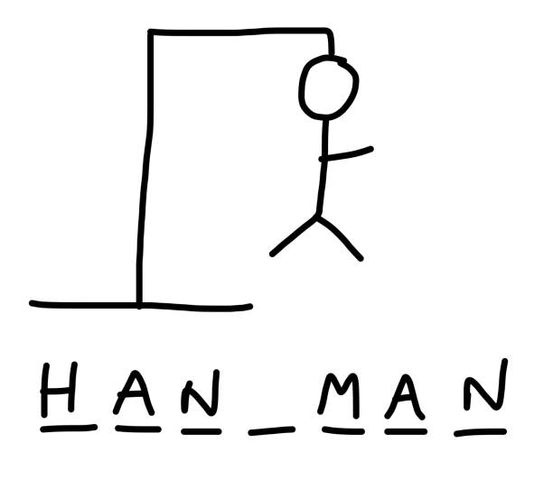
By Toan Lee and Ali Vafaeian

Slide 2
Why we chose this:
We chose to do a hangman game because it seemed like the game that could have the most add on(s) to it. It was also something that could have very easily been done with many functions and that’s what we ended up doing anyways. The other options seemed not as thought provoking to us.

Slide 3
Demo
We will now show a demo of the Hangman game we created as well as break down the program a little...

Slide 4

Important Libraries used
The use of random is done to generate random values to be used.
The use of requests is done to connect the program to the internet to allow the program to get the definition of the word online.

Slide 5
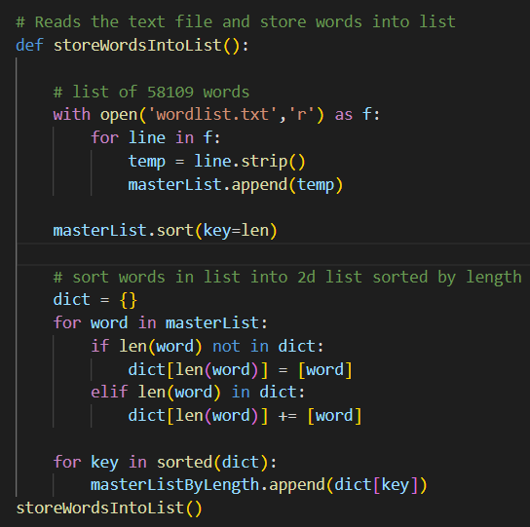
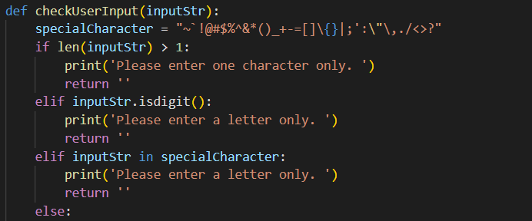
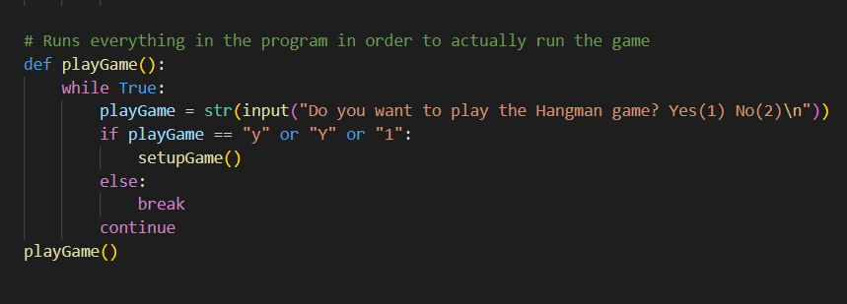
Important segments of code
These are some of the most import parts of the game that we made into functions to run very easily.

Slide 6
Add-on(s)
For this project we added a few things to make this different from a traditional python hangman game.

Slide 7
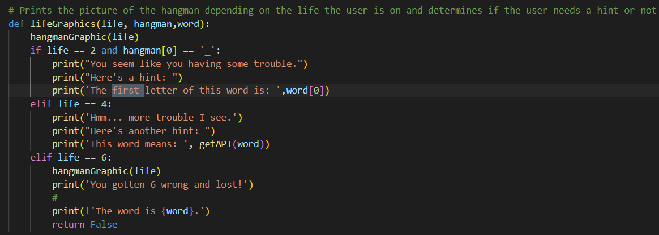
First Add on: Hint system
The first types of hints we did was tell the user what the first letter of the word is after getting two wrong guesses.

Slide 8
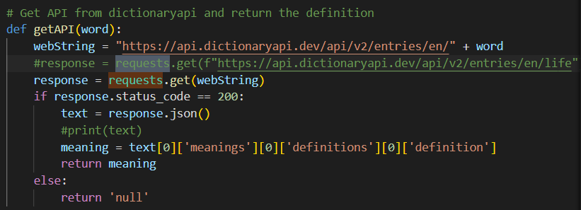
First Add on: Hint system (cont.)
The second type of hint is after the user gets four wrong guesses the definition of the word is given to the user.

Slide 9

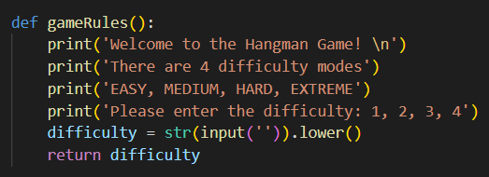
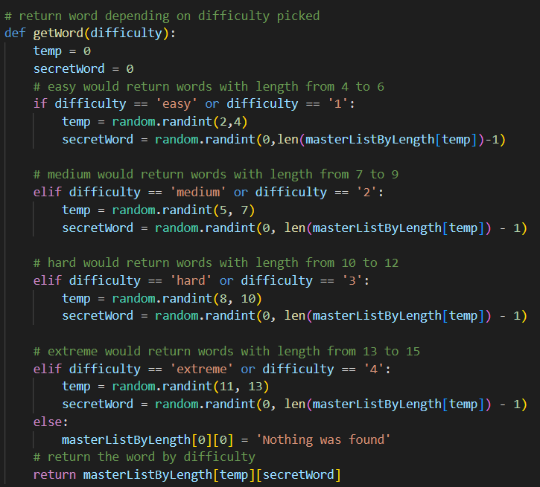
Second Add On: Difficulty System
There are 4 difficulty modes we added. They are easy, medium, hard, and extreme. Depending on the difficulty the length and complexity of the word changes.

